Slide 1
Architectural Home Plan Designing System with Knowledge Base Inspection
Literature Review
R.P.M.C.Rajapaksha
2298
ICT/08/09/018

Slide 2
Steps in the Literature Review
Establish research focus
Identify where to search
Select appropriate search terms
Use ‘operators’ and ‘wildcards’
Organize research history
Determine relevant literature
Analyze, Synthesize and Summarize evidence

Slide 3
Select Appropriate Search Terms
A search term is a term used to find information on topic Search terms can include:
Key words
Author
Title
Journal or publication
Other descriptors

Slide 4
Review of Abstracts
1. What were the issues discussed by the researchers?
2. What methods did they use?
3. What were the results?
4. Are there any missing or inadequate topics?

Slide 5
Research Questions
How to define the logical definition of the house according to the architectural, legal, geometrical and scaling rules.
How to represent the design of the house in a coordinates based approach.
What mechanism should be followed when defining the knowledge base system according to directions and measuring scale.
How to display visually the generated definition of the house plan.

Slide 6
Knowledge-Based Design of Scheduling Systems Jürgen Sauer Universität Oldenburg, FB Informatik Escherweg 2 D-26121 Oldenburg, Germany 2008
Paper 1

Slide 7
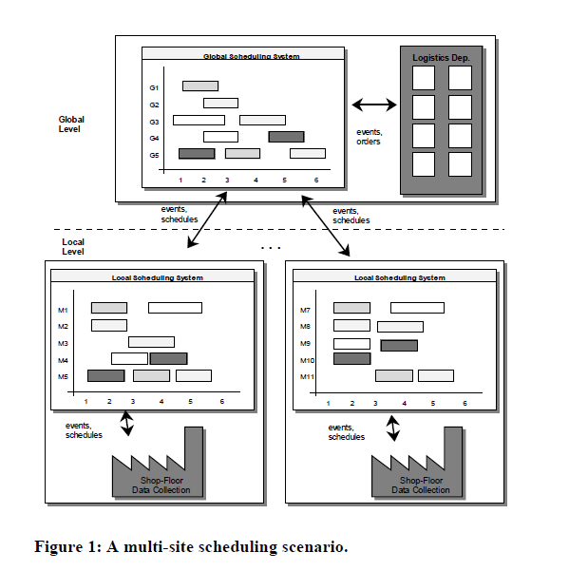

Slide 8
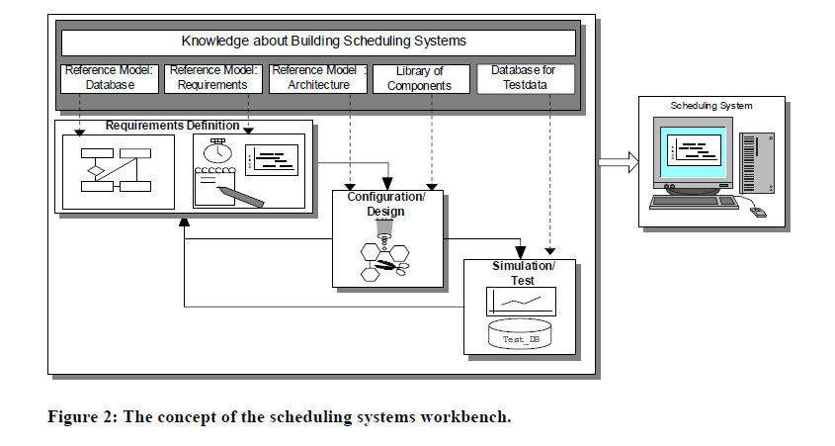

Slide 9
Three levels of scheduling knowledge
On the first level
There is basic scheduling knowledge from Operations Research (OR) and Artificial Intelligence (AI) which is normally coded in scheduling algorithms. These algorithms reach from simple priority rule-based ones to sophisticated ones using problem solving techniques from OR and/ or AI.
On the second level
There is knowledge about the appropriateness of scheduling algorithms based on specific problem situations, e.g., which algorithm is to be used if meeting due dates is the main goal of scheduling.
On the third level
There is the general knowledge about building scheduling systems, e.g., which components are important. The knowledge on level two and three is called meta-knowledge and is integrated in the "knowledge about building scheduling systems" and the “reference model”.

Slide 10
Paper 2
A Prototype Framework for Knowledge-Based Analog Circuit Synthesis*
Ramesh Harjani, Rob A. Rutenbar and L. Richard Carley
Department of Electrical and Computer Engineering
Carnl:gie Mellon University
Pittsburgh, Pennsylvania 15213
2007

Slide 11
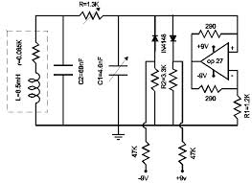
Support high-level circuit synthesis for specific classes of analog functions.
From an input consisting of detailed performance specifications, produce a sized, transistor-level circuit schematic.
The goal is to produce a good first-cut design that is sufficiently “close” to optimal that numerical optimization tools can be applied.

Slide 12
The process of choosing from among these fixed alternatives for the design of a circuit topology is called design style selection.
The fixed alternatives for circuit topologies are specified hierarchically. A topology for a high-level module (e.g., an A/D converter) is specified as an interconnection of sub-blocks, not as an interconnection of transistors.
That the topology is fixed implies only that this arrangement of sub-blocks is fixed.
Because of this explicit hierarchy, one high-level topology of blocks can specify many device level topologies.

Slide 13
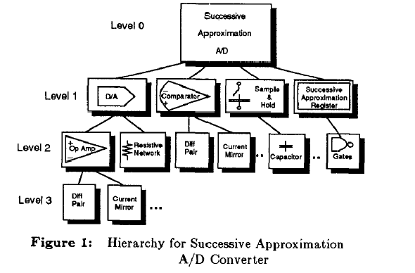

Slide 14
For a single topology selection/translation step, design knowledge is represented in the form of circuit equations and algebraic constraints involving circuit specifications.
The process by which a high-level block specification is translated into sub-block specifications is implemented as a planning system.
Plans are stored with fixed topologies, and executed when the topology is instantiated.
Rules fire at the end of each plan step to correct errors, and modify the dynamic flow of the plan.

Slide 15
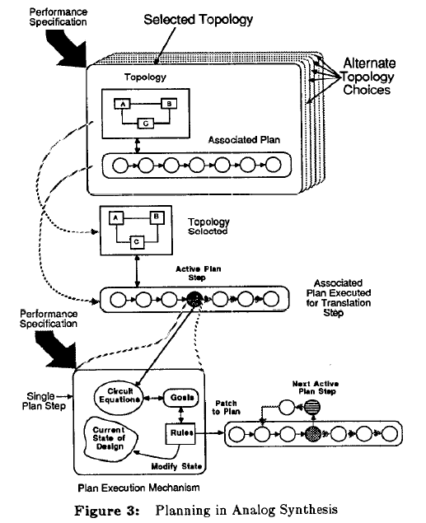

Slide 16
Paper 3
INTEGRATING DESIGN AND PRODUCTION PLANNING
WITH KNOWLEDGE-BASED INSPECTION PLANNING
SYSTEM
Ghaleb Y. Abbasi*
Industrial Engineering Department, Faculty of Engineering & Technology, University of
Jordan
Hussein S. Ketan and Mazen B. Adil
Industrial Engineering Department, University of Technology, Baghdad, Iraq
2009

Slide 17
CADIP
A hybrid knowledge-based approach integrating computer-aided design (CAD) and computer-aided inspection planning (CAIP) was developed, thereafter called computer-aided design and inspection planning (CADIP).

Slide 18
Features
1. Using Feature Based Design technology.
2. Development of algorithms and techniques to evaluate actual geometric tolerances using measurement data.
3. Development of techniques for automatic generation for inspection programs from current CAD database.
4. Application of artificial intelligent (AI) expert system in the building of inspection process planning systems.

Slide 19
Typical automating planning
Find the abstract shape information (higher-level feature) in a part
Determine the relationships between the features.
Automated inspection planning
Component/probe orientation strategy.
Probe point placement algorithms and probing density.
Determine, on the basis of the above information, the physical entities (edges, etc.) to be measured.
Determine the possible probe locations and a probe direction
Minimize probing operations while achieving successful measurement of all entities (optimization).
Sequence of probing
Clash avoidance clash detection/evasion.
Generation of DMIS programs.

Slide 20
Methodology is achieved via the following:
1. Rules, structures, and pointers-based representation of knowledge and modeling of behavior of the individual components in the design and inspection planning
2. Developing other necessary components such as interfaces data models to achieve the integrated environment.
3. Developing a flexible approach for design by feature, feature recognition of 3-D prismatic parts, and a knowledge-based geometric reasoning approach for automated inspection planning.

Slide 21
Preparation of an inspection knowledge base entails the listing of
1. Working faces in which features are created.
2. High-level feature types created on a certain working face.
3. Feature directions and probe locations.
4. The settings for each feature, which are determined by, feature type and direction.
5. Inspection parameters and measuring edges for each setting.
6. Edge limits and edge value.
7. Probe approach directions and probe inspection directions for measurable edges for each setting.

Slide 22
In order to automate the inspection planning, inspection attributes are stored in CAD database along with geometric model.
Geometric knowledge consists of a hierarchal description including part CAD boundary representation, which consists of the description of faces, edges, and vertices.
Since this information is not sufficient for the required reasoning at higher description level, information about the type of shape features such as steps, holes, etc. and its locations represented and tied with lower level descriptions.
The function of inspection planning module is to generate the inspection attributes, inspection points, and probing directions for the selected feature attributes.

Slide 23
Paper 4
Game Artificial Intelligence
Literature Survey on Game AI
VENKATARAMANAN.K
U058557W
Supervisor: Dr. Xu Jian Xin
2009

Slide 24
The current methods which are used for implementing Game AI
Vary from
Neural network
Bayesian technique
Genetic algorithms
Finite state machines
Path finding
All these methods are feasible but not applicable in every situation given.

Slide 25
Path finding and Steering
Path finding addresses the problem of finding a good path from the starting point to the goal, avoiding obstacles, avoiding enemies, and minimizing costs in the game.
Movement addresses the problem of taking a path and moving along it.
At one extreme, a sophisticated pathfinder coupled with a trivial movement algorithm would find a path when the object begins to move and the object would follow that path, oblivious to everything else.
At the other extreme, a movement-only system would not look ahead to find a path (instead, the initial "path" would be a straight line), but instead take one step at a time, considering the local environment at every point.
The gaming industry has found out that the best results are achieved by using both path finding and movement algorithms.

Slide 26
Finite State Machines and Decision Trees
Finite State Machines (FSMs) describe under which events/conditions a current state is to be replaced by another.
The boxes represent states, which involve specific scripts, animation schemes, etc. AI is often implemented with finite state machines (FSM's) or layers of finite state machines, which are difficult for game designers to edit.
Looking at typical AI FSM's, there are design patterns that occur repeatedly. One can use these patterns to make a custom scripting language that is both powerful and approachable.
The technique can be further extended into a "stack machine" so that characters have better memory of previous behaviors.

Slide 27
Neural Networks
Neural networks can be used to evolve the gaming AI as the player progresses through the game.
The best thing with neural networks is that they will continually evolve to suit the player, so even if the player changes his tactics, before long, the network would pick up on it.
Some advantage of neural networks over traditional AI are, using a neural network may allow game developers to simplify the coding of complex state machines or rules-based systems by relegating key decision-making processes to one or more trained neural networks and neural networks offer the potential for the game's AI to adapt as the game is played.
The biggest problem with Neural Networks programming is that no formal definitions of how to construct an architecture for a given problem have been discovered, so producing a network to perfectly suit your needs takes a lot of trial-and-error.

Slide 28
Genetic Algorithms
Genetic algorithms offer a way to solve problems that are difficult for traditional game AI techniques.
We can use a genetic algorithm to find the best combination of structures to beat the player. So, the player would go through a small level, and at the end, the program would pick the monsters that faired the best against the player, and use those in the next generation.
Slowly, after a lot of playing, some reasonable characteristics would be evolved. Genetic algorithms (GAs) are one of a group of random walk techniques.
These techniques attempt to solve problems by searching the solution space using some form of guided randomness. Another technique of this type is simulated annealing. Larger populations and more generations will give us better solutions.
This means that Genetic Algorithms are better used offline. One possible way of doing this is by doing all of the Genetic Algorithm work in-house and then releasing an AI tuned by a GA.
By having a GA engine to work on the user’s computer while the game is not being played this can be achieved to a certain extent.

Slide 29
Learning methods
Q –learning
Q-learning is a type of reinforcement learning technique that works by learning an action-value function that gives the expected utility of taking a given action in a given state and following a fixed policy thereafter.
One of the main advantages of Q-learning is that it is able to evaluate the expected utility of the existing actions without requiring a model of the environment.
Q-Learning at its simplest uses tables to store data. This very quickly loses viability with increasing levels of complexity of the system it is monitoring/controlling.
This reduces the feasibility of the learning technique. Hence Q-learning is not a very famous implementation for machine learning.
One answer to this problem is to use an adapted Artificial Neural Network as a function approximation.

Slide 30
Bayesian learning
Bayesian learning is a method by which players in a game attempt to infer each other's future strategies from the observation of past actions.
We study the long-run behaviors of the players in evolutionary coordination games with imperfect monitoring. In each time period, signals corresponding to the players underlying actions, instead of the actions themselves, are observed.
The rational quasi-Bayesian learning process is proposed to extract information from the realized signals. We find that player’s long-run behaviors depend not only on the correlations between actions and signals, but on the initial probabilities of risk-dominant and non-risk-dominant equilibrium being chosen.
Bayesian learning is one of the most implemented learning techniques and has been found to be very feasible by the game AI developers.

Slide 31
Conclusion
Still researchers could not find a way to design and represent a home plan with knowledge base inspection. And to validate the design according to the architectural, legal and geometrical rules.

Slide 32
Thank You

